Slide 1



Analysis Of Thermodynamic Cycles For Nuclear Thermal Rockets
Tristan Muzzy
Dr. Neil Sullivan
College of Engineering

Slide 2
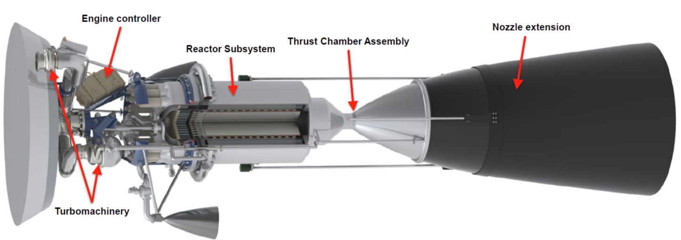

What Is NTP?
NERVA program 1961-1973
Strategic Defense Initiative 1983
New DARPA project 2023
https://www1.grc.nasa.gov/research-and-engineering/nuclear-thermal-propulsion-systems/

Slide 3
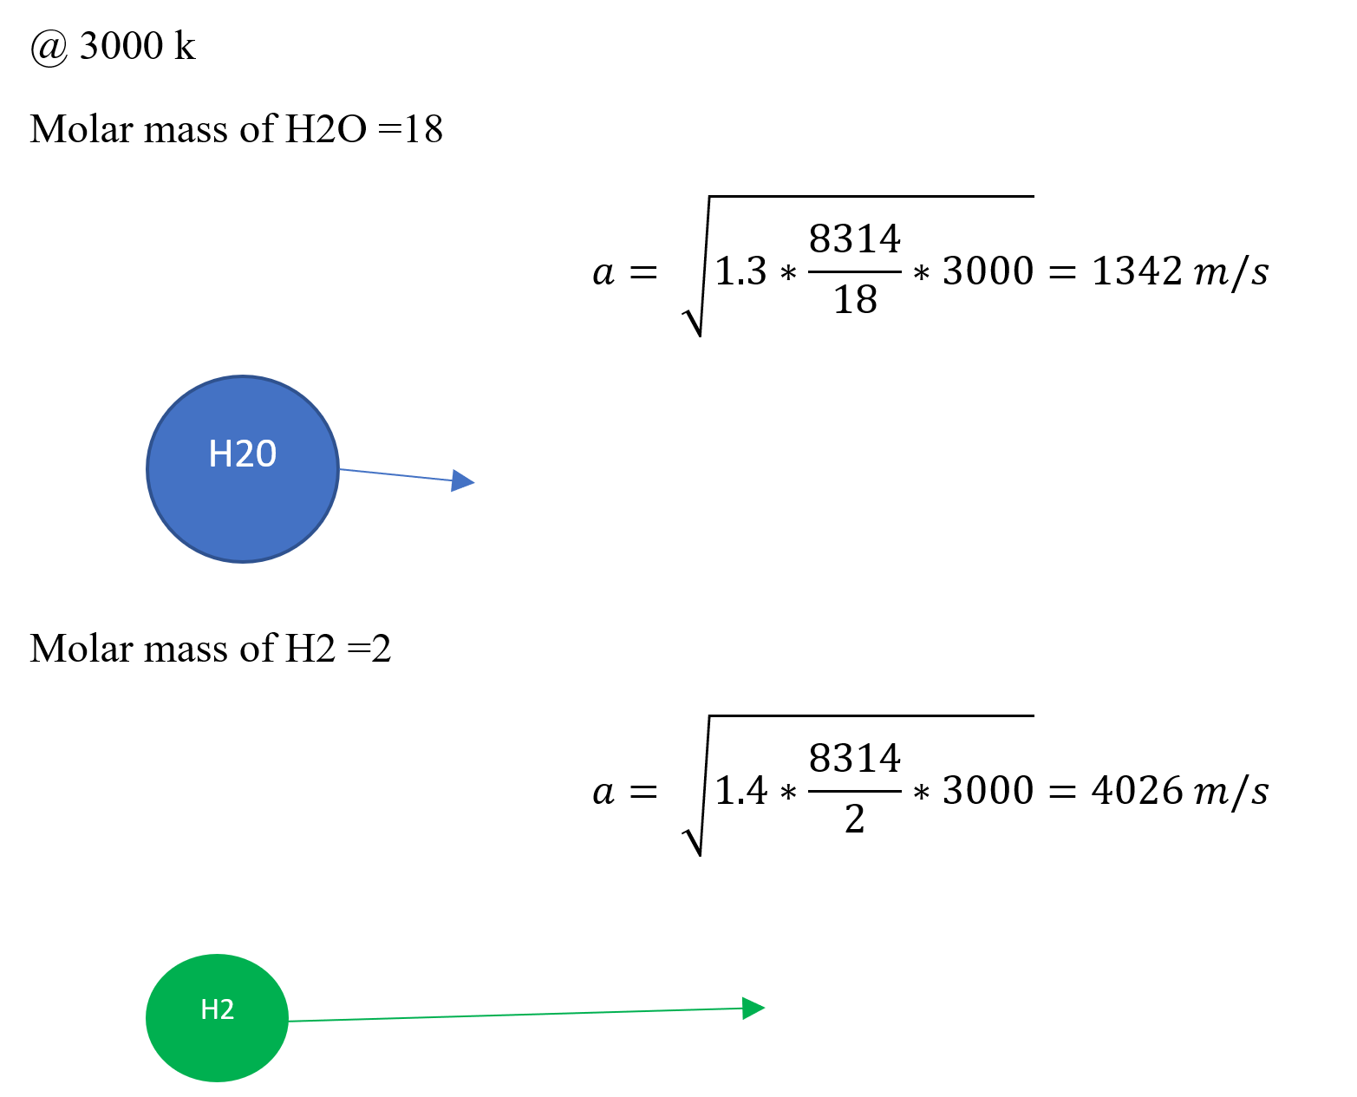
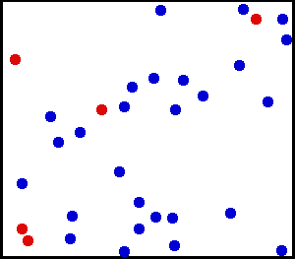
Why is NTP better than conventional Propulsion?
https://commons.wikimedia.org/wiki/File:Translational_motion.gif
Notes:
Heavy particles move significantly slower with the same kinetic energy (added heat) as light particles 0.5mv^2
But for rocket propulsion we only care about momentum, p=mv, so that square really hurts your efficiency
Using lighter propellants allows for a faster thrust for the same energy input and temperatures

Slide 4
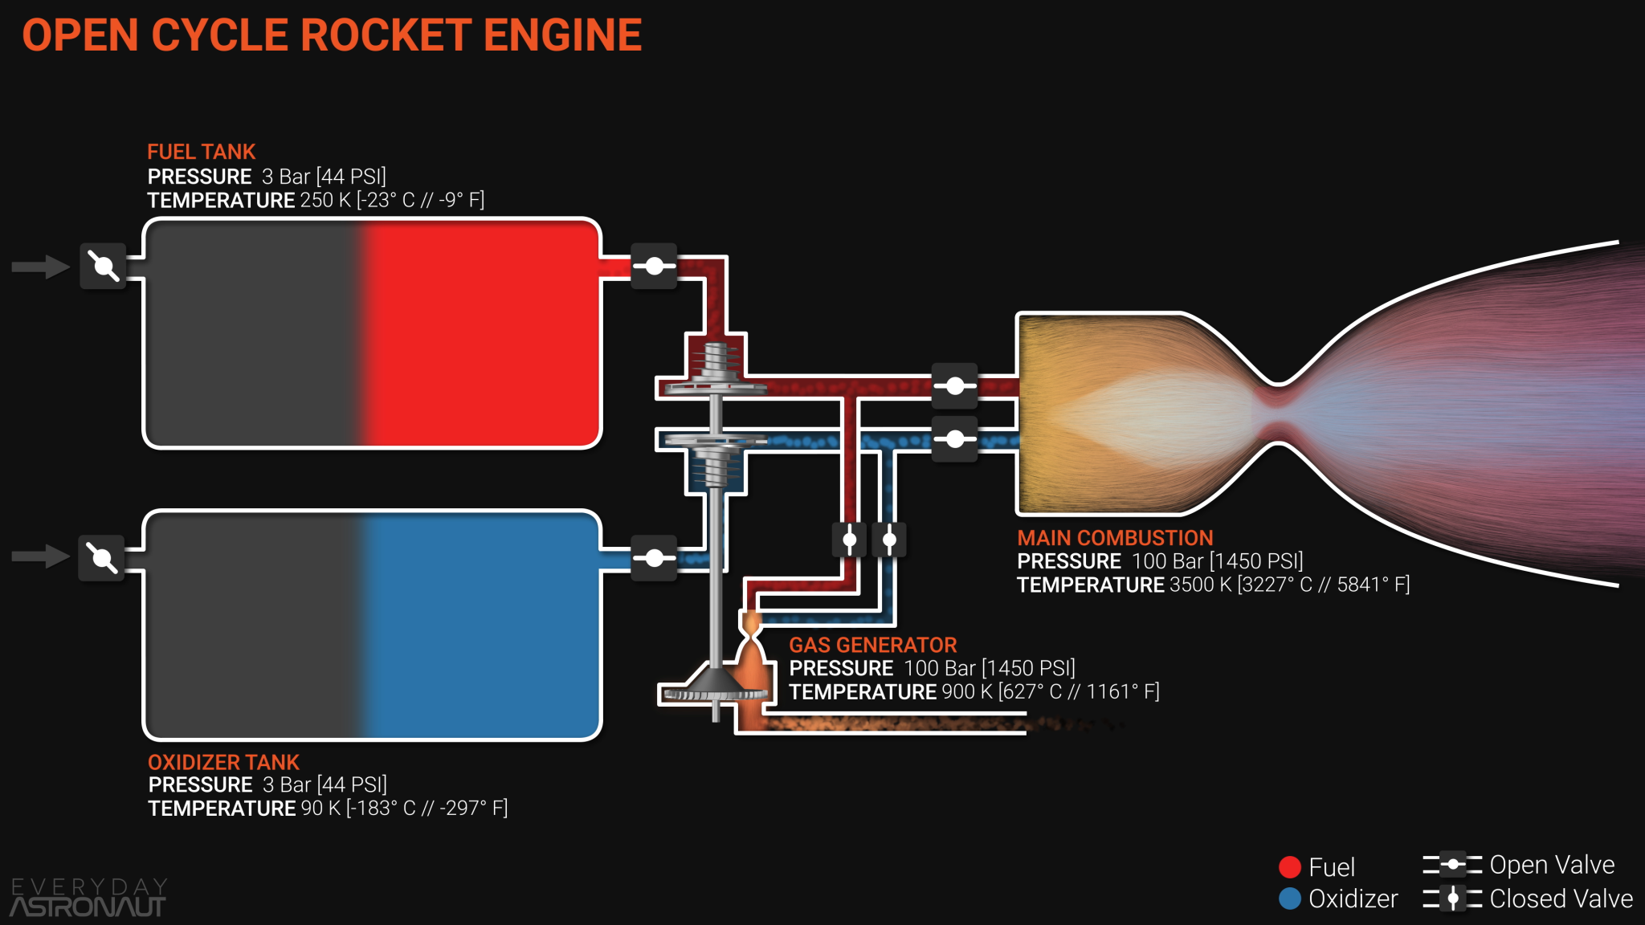
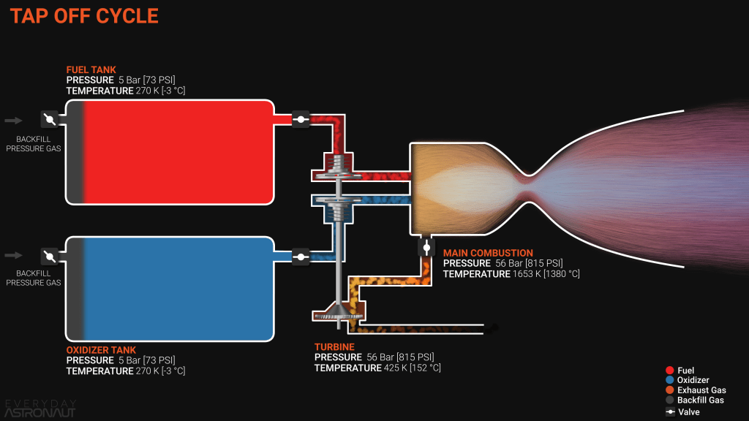
How do Chemical Rocket Cycles work?
https://everydayastronaut.com/rocket-engine-cycles/

Slide 5
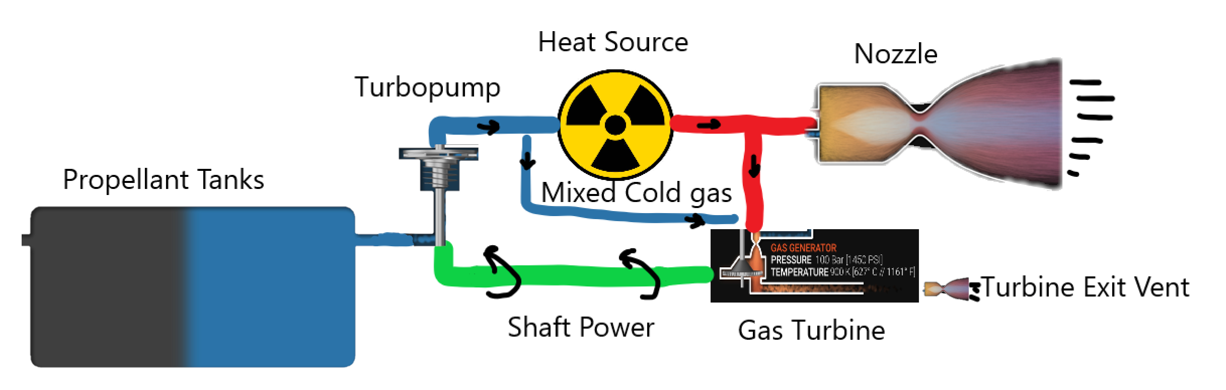
How Is NTP Different?
https://www.istockphoto.com/vector/radioactive-warning-yellow-circle-sign-radioactivity-warning-vector-symbol-gm1202947205-345560002

Slide 6
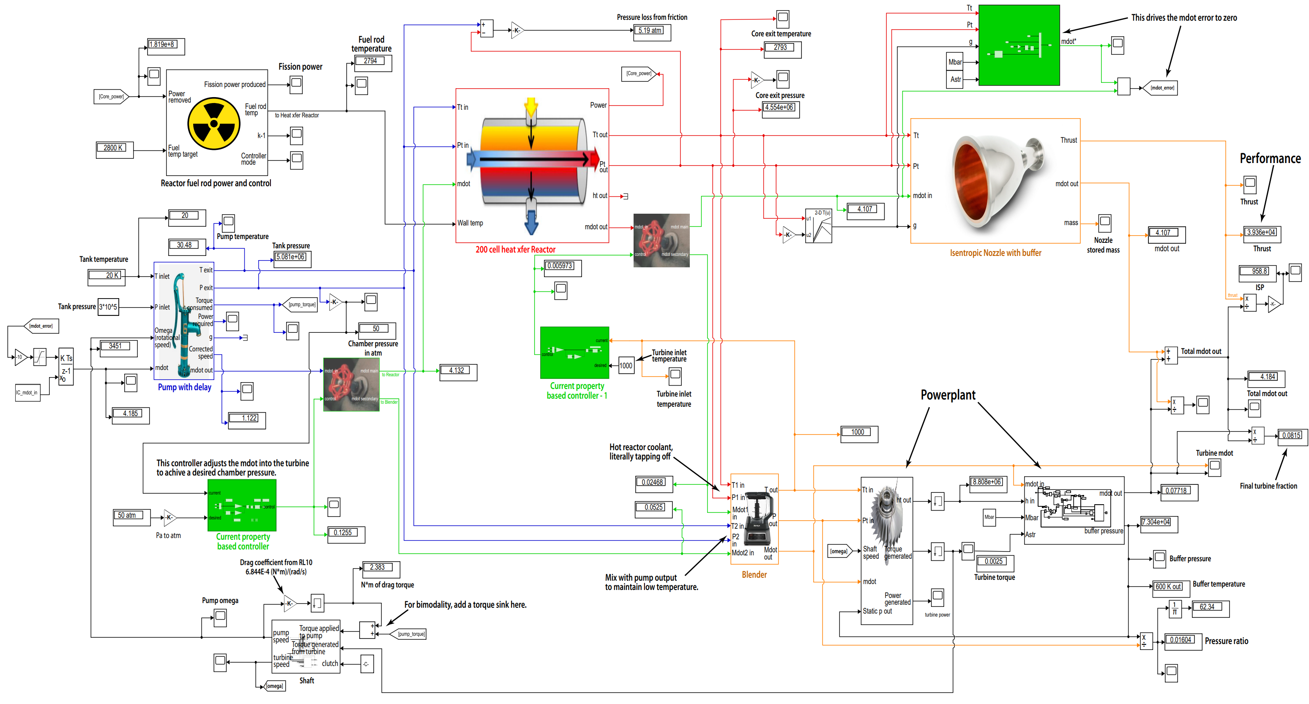
How does my code work?
Notes:
Forward Euler integration to model transients in engine startup/shutdown
Lookup tables for gas properties
Convection in a pipe in the core

Slide 7
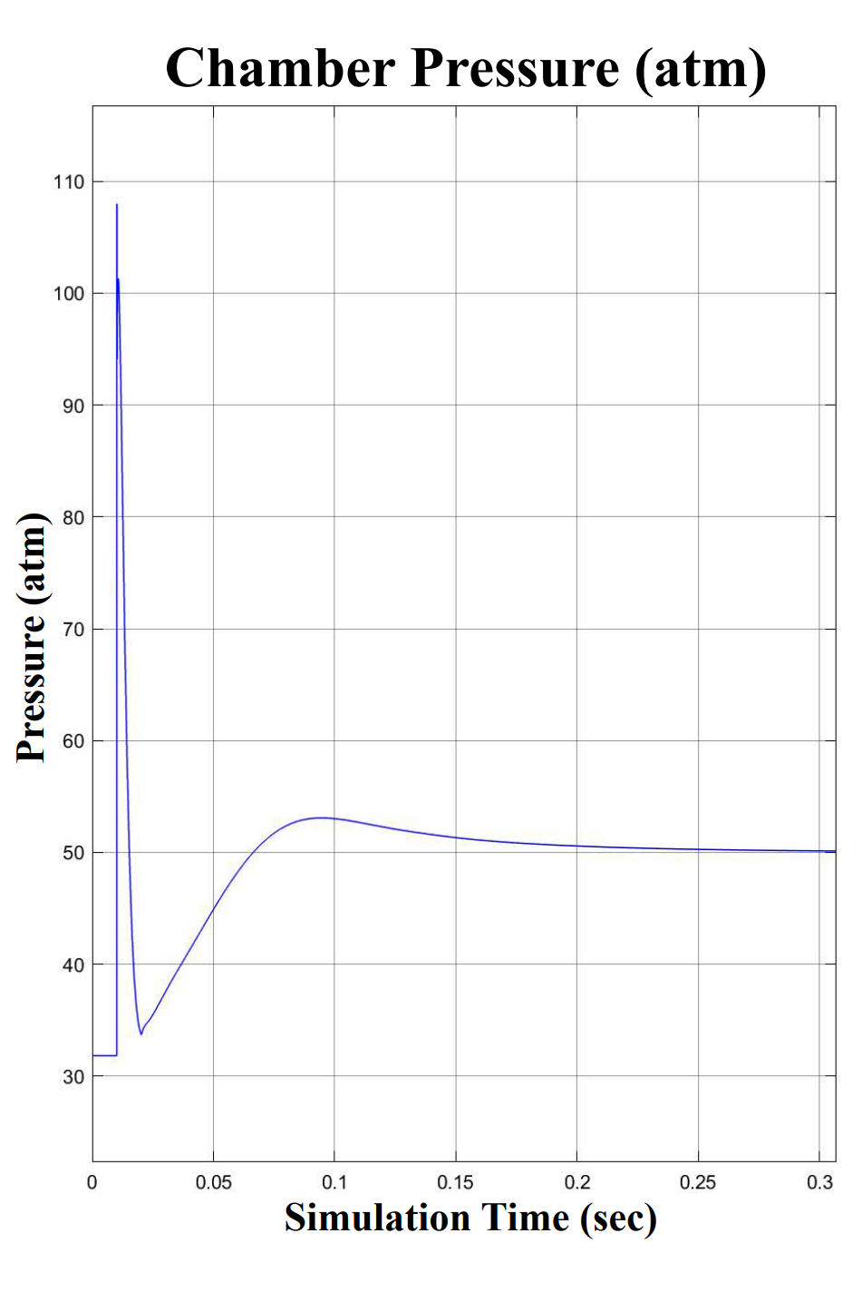
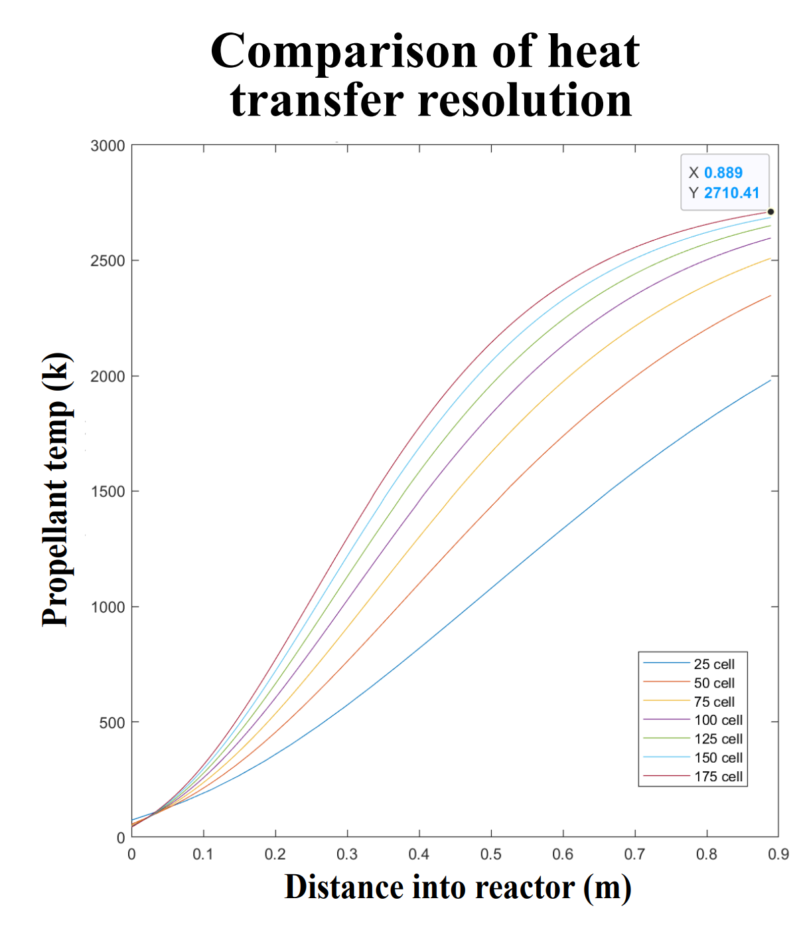
What’s not right?

Slide 8
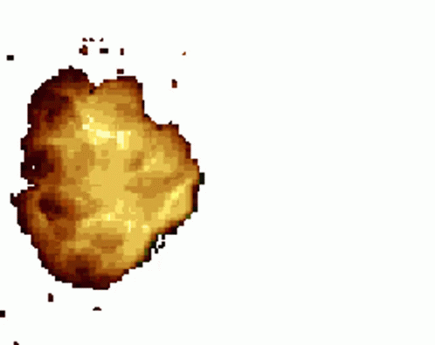
But It can Run Transients
Pressure Drop
More mass into the turbine
Slow Ramp
Pressure rise from Choke
Efficiency Drop
Really big Efficiency drop
Power Rise
https://tenor.com/view/explosion-gif-transparent-gif-26964282
Notes:
Test ramp to mdot failure at 21 kg/s. (start 5.6kg/s 0.1s slope 1, end 17 sec)
Higher mdot in core caused friction pressure drop from 80 to 35 atm
turbine was handling high mdot fine until back-pressure reached near 20 atm
Low pressure ratio across turbine (inlet is equal to core exit bc/ mixer) caused decrease in torque, so the controller puts more mdot into turbine, further increasing backpressure to match mdot_star.
This then passed the pressure ratio >1, resulting in extreme negative torque,
Lowering omega.
controller compensates incorrectly and core pressure gets lower generating more negative torque, untill omega <0
Then NaN from there

Slide 9
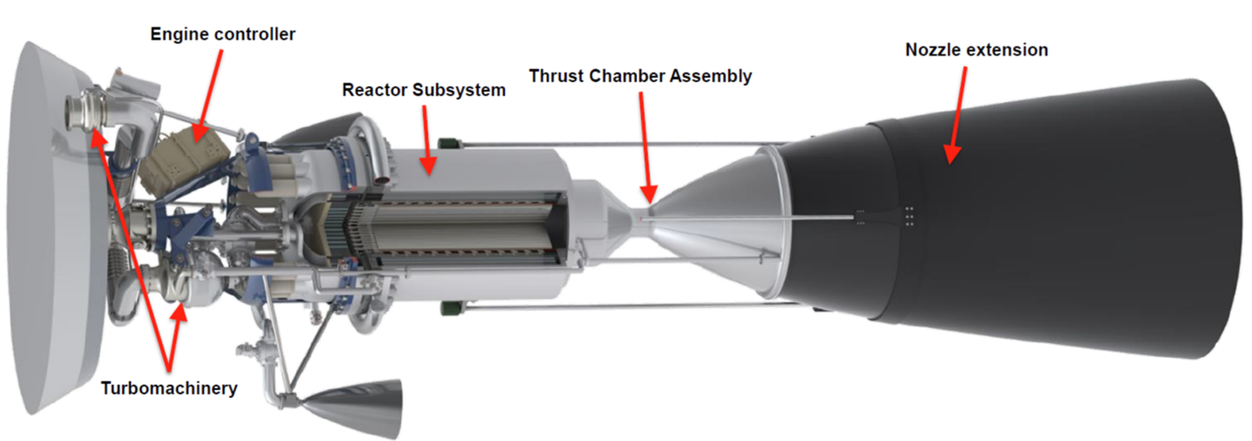

Summary
Engine Controls are Hard
Understanding how an engine behaves early leads to better designs
Simple Techniques can be used to make complex models

Slide 10


